Slide 1





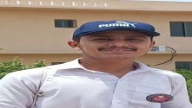

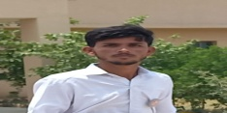

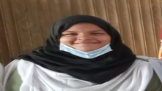



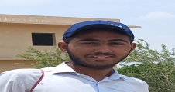






FC PUBLIC SCHOOL & COLLEGE,
Kohlu- Balochistan
Name: Khair Gul
F. Name: Band ALi
Class: X
Marks obtained: 1100/1007
Percentage: 91.55%
Federal board of intermediate education Islamabad

